Slide 1
Multi-Augmentation Strategies for Self-Supervised Learning
Tran Van Nhiem

Slide 2
Proposed Content
1.
2.
Disentangle (Representation Learning)
Data Augmentation Overview
Supervised- Self Supervised
3.
4.
Proposed Multi-Augmentation Strategies.
Proposals Method Pipeline
5.
Proposal Method Schedules – Expected Results

Slide 3
1.
Disentangled Representation Learning

Slide 4
Task1
Task2
Task3
……
Task N
What makes good representation Learning ?
Representation
Deep Neural Net
Inputs 1
……
Inputs N

Slide 5
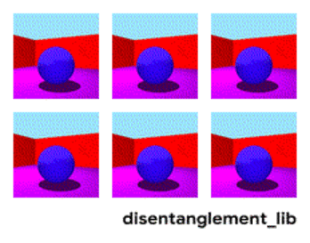
Disentangled Representation
Visualization of the ground-truth factors of the Shapes3D data set: Floor color (upper left), wall color (upper middle), object color (upper right), object size (bottom left), object shape (bottom middle), and camera angle (bottom right). Image source: Link

Slide 6
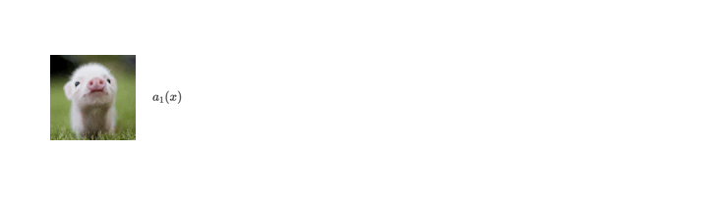
Disentangled Representation
(Data Augmentation)
Color Representations
Image source

Slide 7
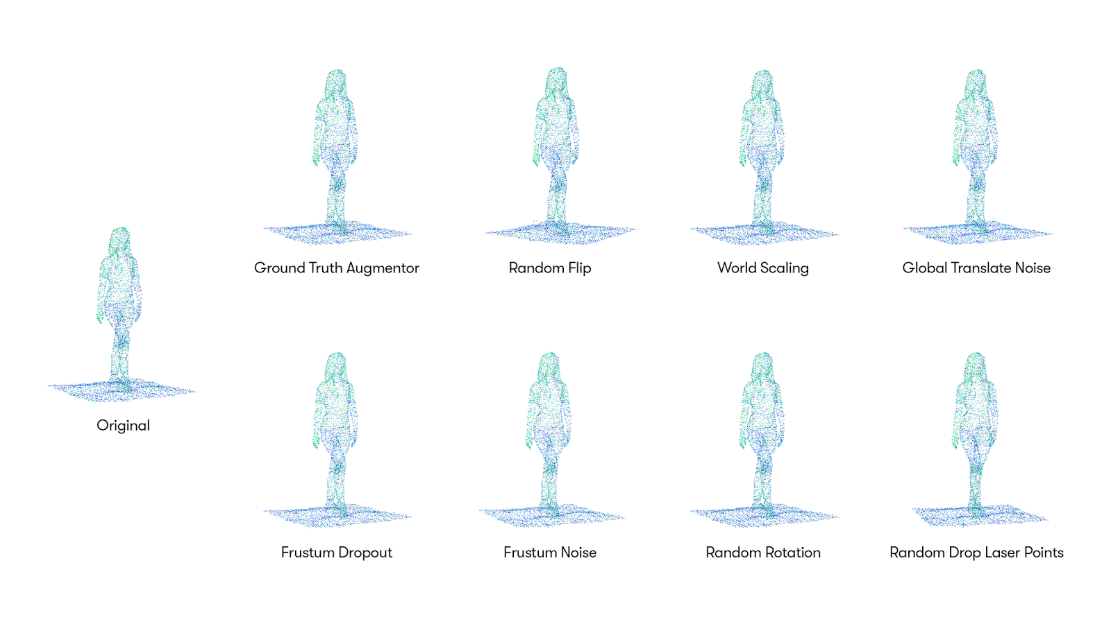
Disentangled Representation
Data Augmentation
Shape – Size – Geometric Representations
Image source: Link address

Slide 8
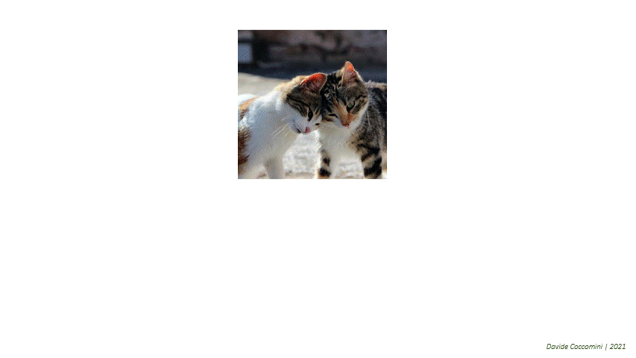
Disentangled Representation
Data Augmentation
Local – Global Semantic Representations
Image source

Slide 9
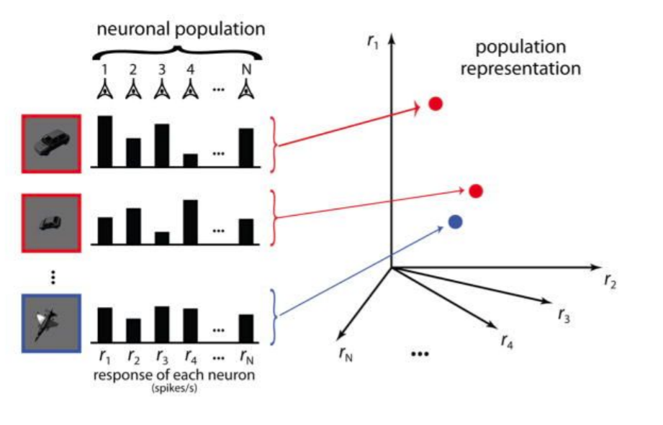
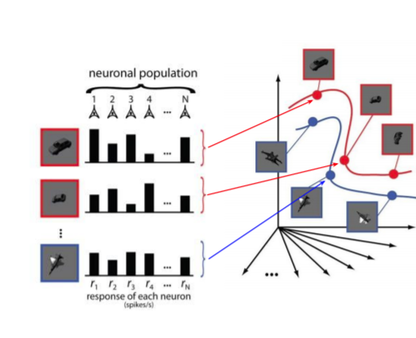
Untangling representations
High dimensions of the variant of input signals
Inputs signals
This will make problem much harder when the inputs now increasing at scales
Image Source

Slide 10
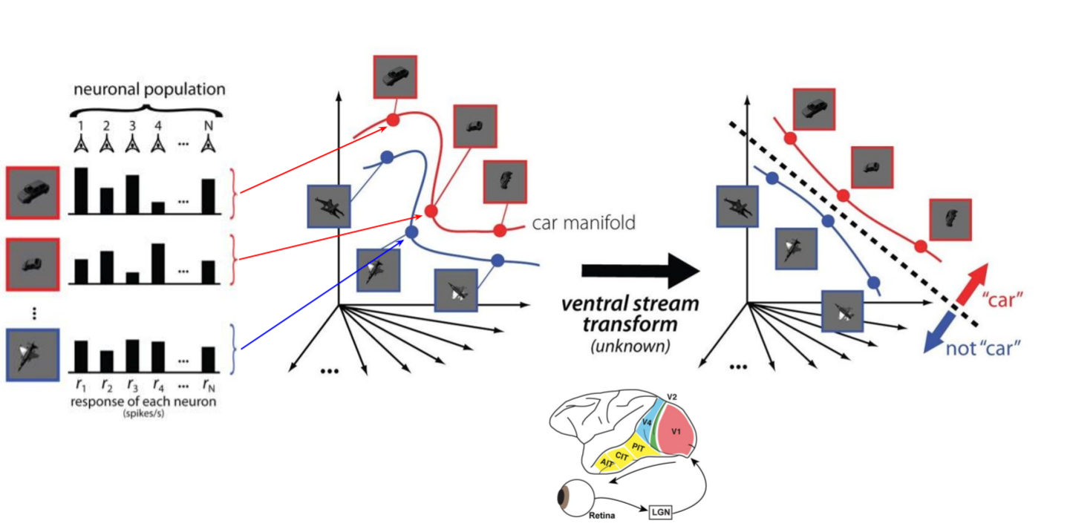
Untangling representations
Image Source

Slide 11
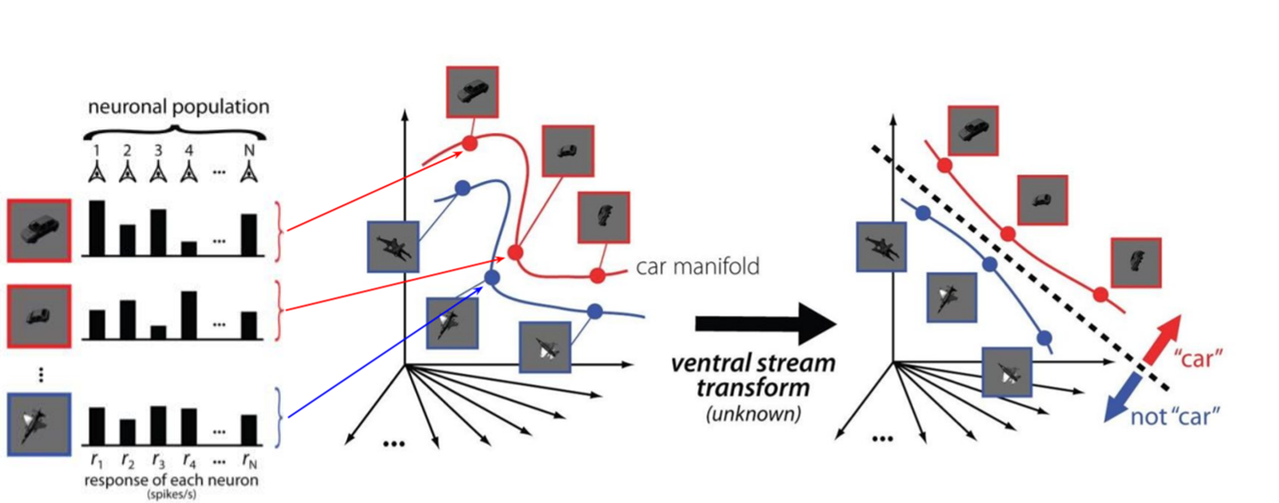
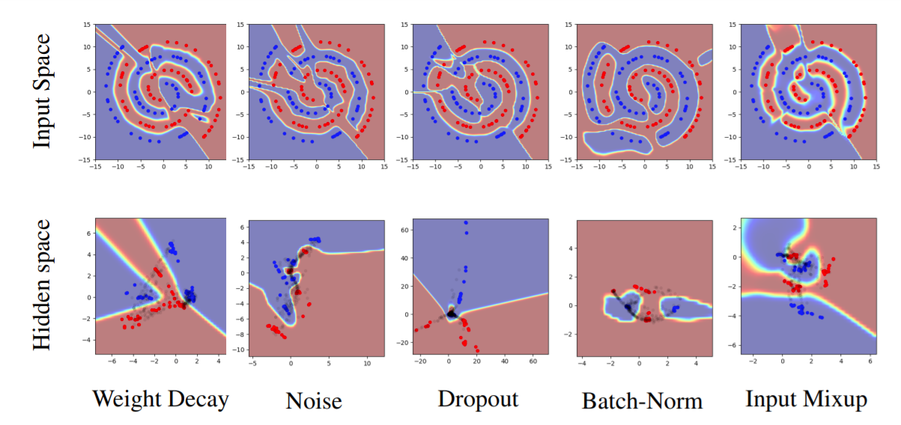
Untangling representations
Current REGULARIZATION techniques seem to helps Smooth the hard boundary and push the population close together
Image Source

Slide 12
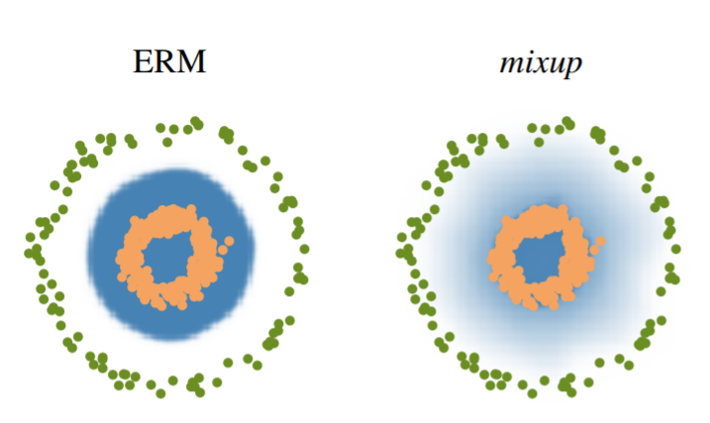
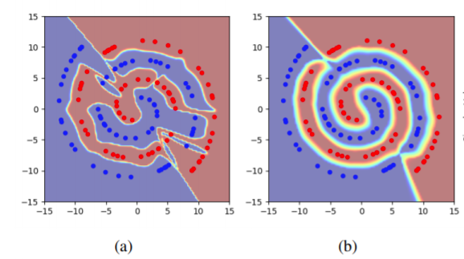
Untangling representations
Current REGULARIZATION techniques seem to helps (Mixup, up Manifold-Mixup, Others) Smooth the hard boundary and push the population close together
Image Source
Image Source

Slide 13
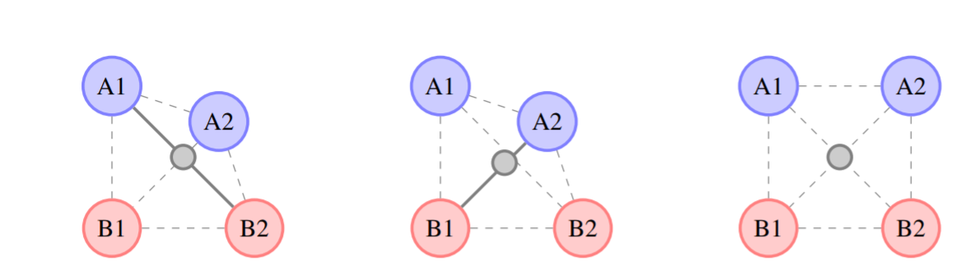
Untangling representations
Current REGULARIZATION techniques seem to helps (Mixup, up Manifold-Mixup, Others) Smooth the hard boundary and push the population close together
Image Source

Slide 14
2.
Data Augmentation Strategy
Supervised & Self-Supervised
Literatures Overviews

Slide 15
Supervised Learning Data Augmentation Strategies

Slide 16
What are efficient Augmentation Searching methods Supervised Learning ???

Slide 17
Supervised Learning –Data Augmentation
1. Random Strategy
Random Search picks the point randomly from the configuration space.
Hyperparameter 2
Hyperparameter 1

Slide 18
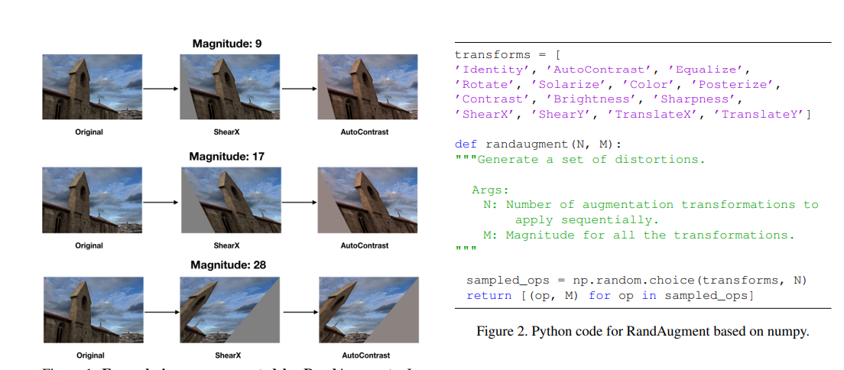
Supervised Learning –Data Augmentation
RandAugment Cubuk et al. 2019 (GoogleBrain)
Transformations & Magnitude (T=2, M=7) [T (0-14) M(0-30)

Slide 19
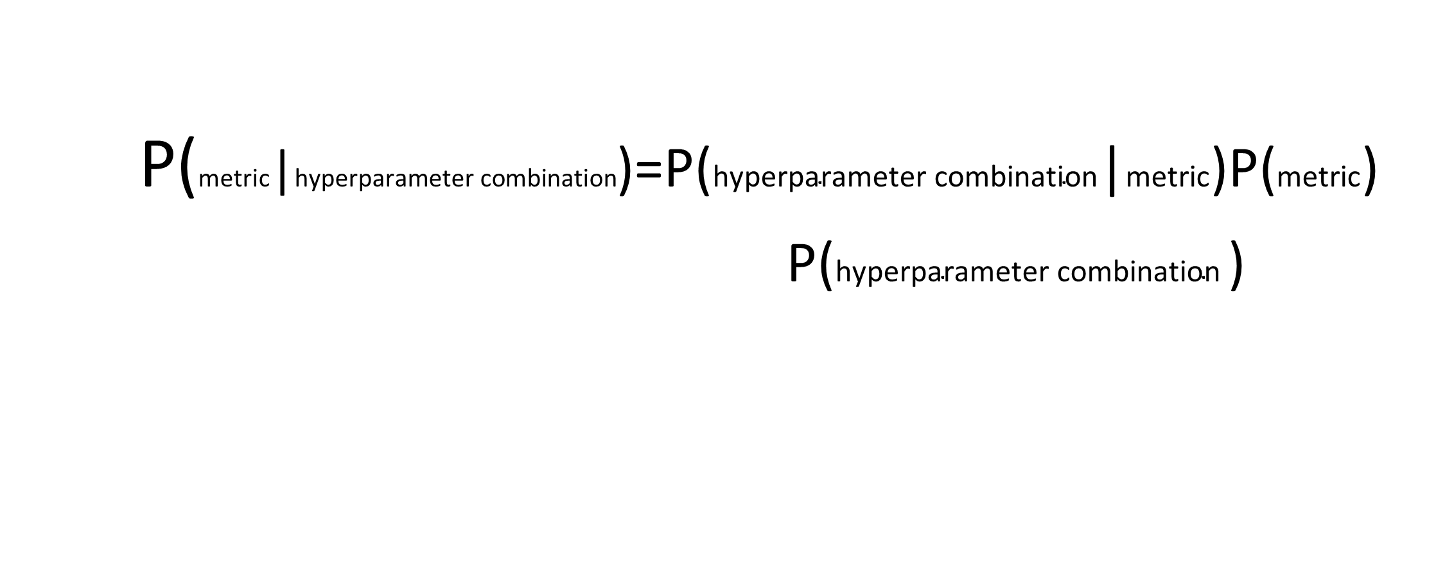
2. Bayesian Optimization Strategy
Supervised Learning –Data Augmentation
P(metric|$\text{hyperparameter} \text{combination}$)=P($\text{hyperparameter} \text{combination}$|$\text{metric}$)P($\text{metric}$)
P($\text{hyperparameter} \text{combination}$ )

Slide 20
Bayes’ Theorem
Supervised Learning –Data Augmentation
P(a | b) = P(a) P(b | a)
P(b)
posterior
prior
likelihood
marginal likelihood

Slide 21

Bayes’ Theorem
Given clouds in the morning, what's the probability of rain in the afternoon?
P(a | b ) = P( ) P( b | a )
P( b )
40% of days have cloudy mornings (Initial Hypothesis)
10% of days have rainy afternoons
P(a | b ) = 0.1 * 0.7
0.4
(Evidence)
70 % of rainy afternoons start with cloudy mornings

Slide 22
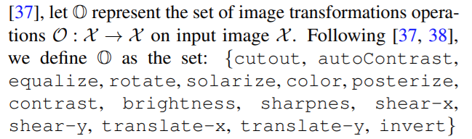
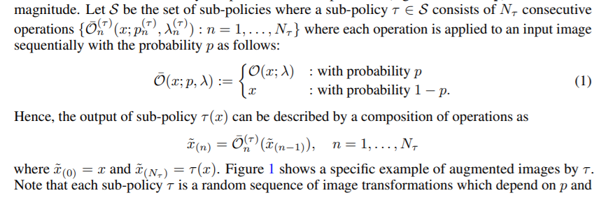
Supervised Learning –Data Augmentation
Fast Auto Augmentation Lim et al 2019
Policy Bayesian optimization Search

Slide 23
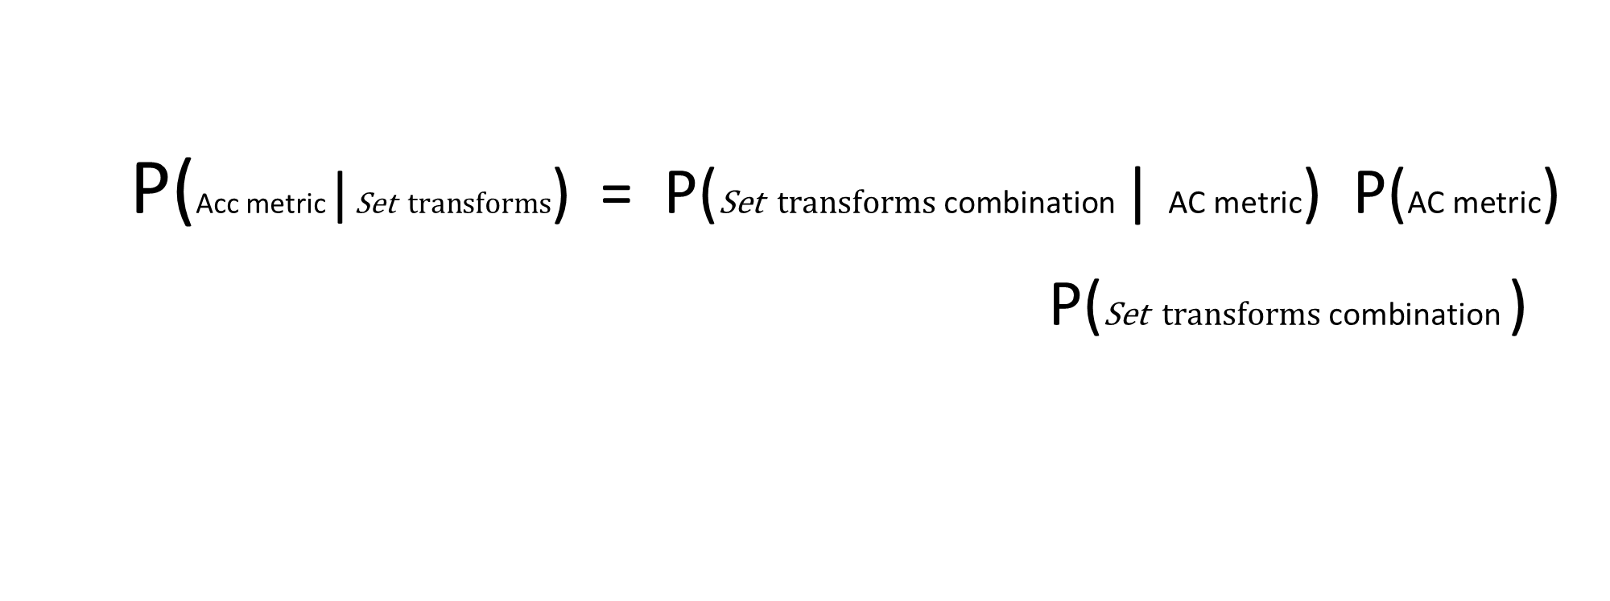
We Try to Apply Bayes’ Theorem Hyperparameter Optimization
P(Acc metric|$\text{Set} \text{transforms}$) = P($\text{S}\text{et} \text{transforms} \text{combination}$ | $\text{AC} \text{metric}$) P($\text{AC} \text{metric}$)
P($\text{Set} \text{transforms} \text{combination}$ )
is the probability of given metric to be minimized/maximized given the combination of hyperparameter.
is the probability of a certain hyperparameter combination IF the given metric is minimized/maximized.
is The initial metric quantity.
is the probability of getting that particular hyperparameter combination

Slide 24
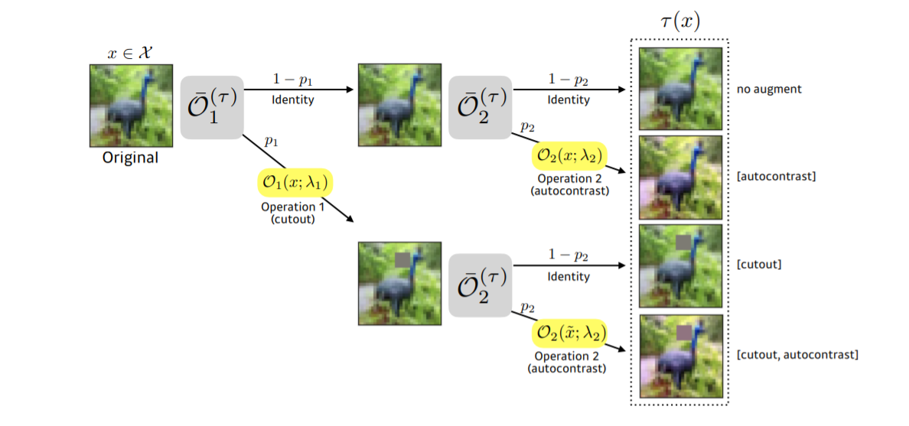
Supervised Learning –Data Augmentation
Fast Auto Augmentation Lim et al 2019
Policy Bayesian optimization Search

Slide 25
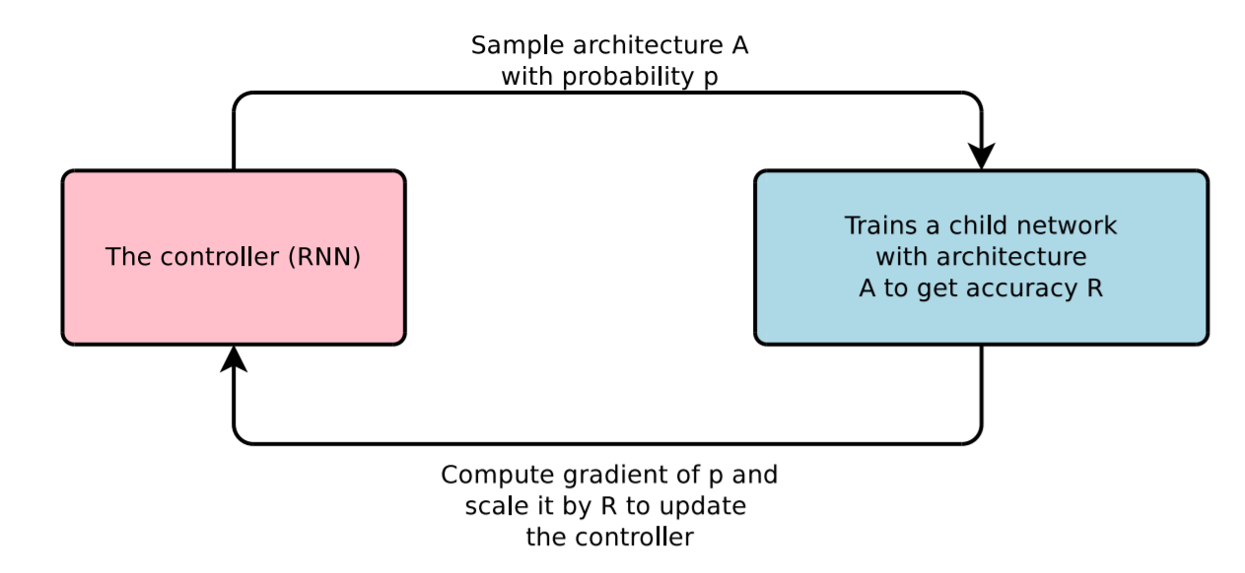
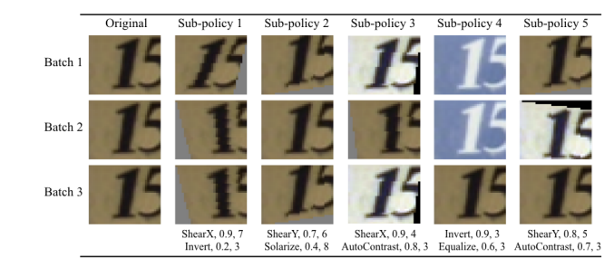
Supervised Learning –Data Augmentation
Auto Augmentation
Neural Architecture Search with Reinforcement Learning (Policy Gradient) Zoph & Le ICLR, 2017

Slide 26
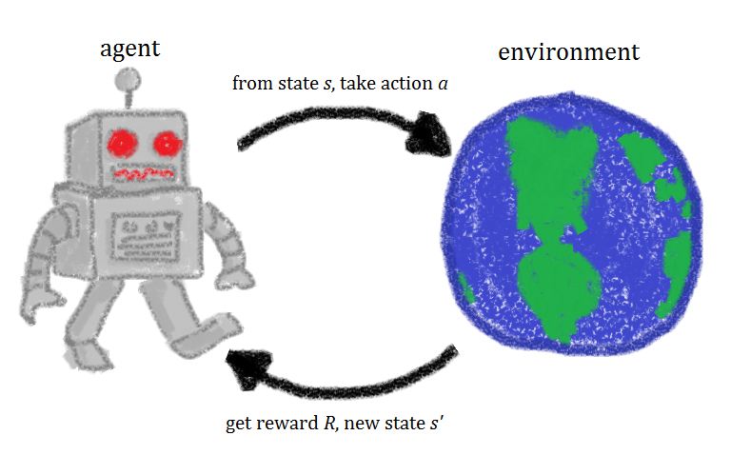
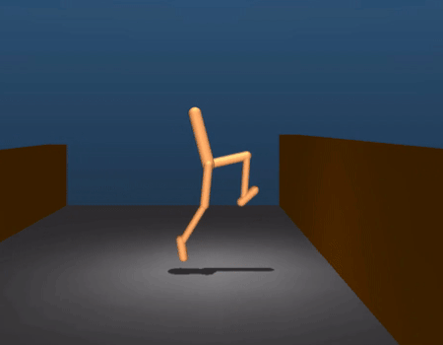
3. Reinforcement Learning
Given a set of rewards or punishments, learn what actions to take next in the future
This image © Zalando Reserach
Image source : https://gfycat.com/

Slide 27
Reinforcement Learning Algorithm
RNN -- LSTM
Sample models A with probability p
Controller
Trainer
Iteration N times find the best Policies
Accuracy
Reward
Compute Gradient of P and scale it by R to update the controller

Slide 28
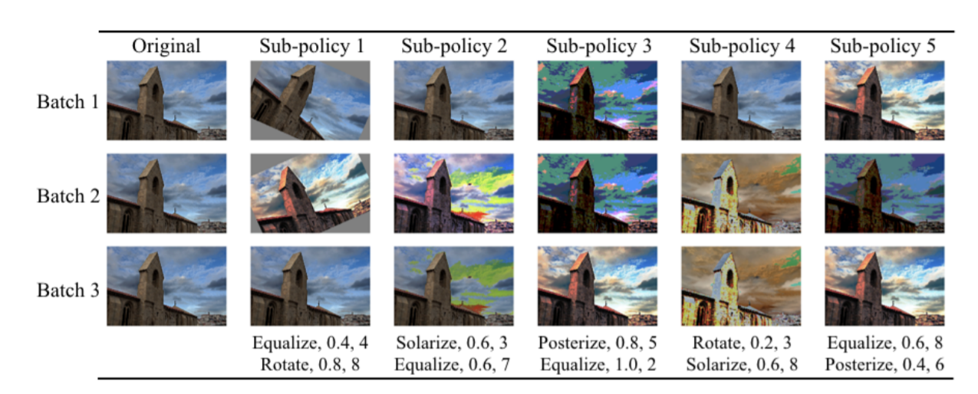
Policy Strategy Auto-Augmentation Data-Augmentation
Reinforcement Learning

Slide 29
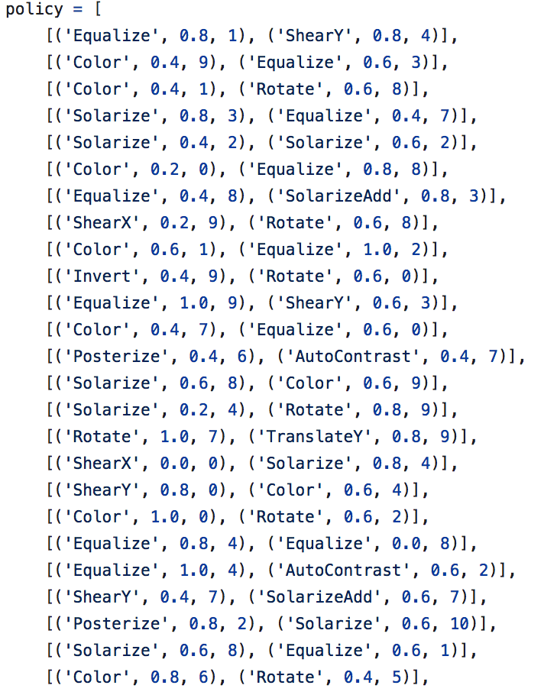
Policy Strategy Auto Augmentation Data-Augmentation
Reinforcement Learning

Slide 30
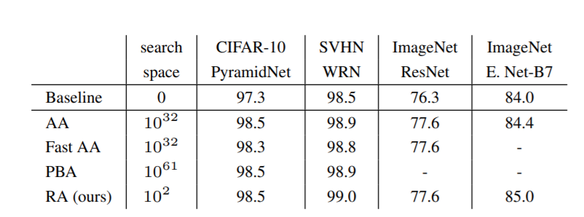
Benchmark Result These Strategies
RandAugment Cubuk et al. 2019 (GoogleBrain)
Image source

Slide 31

Handcrafted Vs Random Search Strategy
Grid Search
Random Search

Slide 32
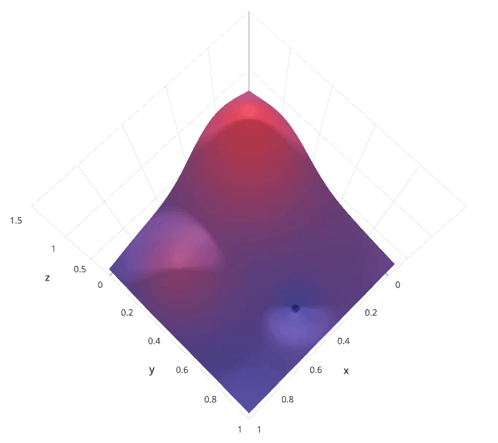

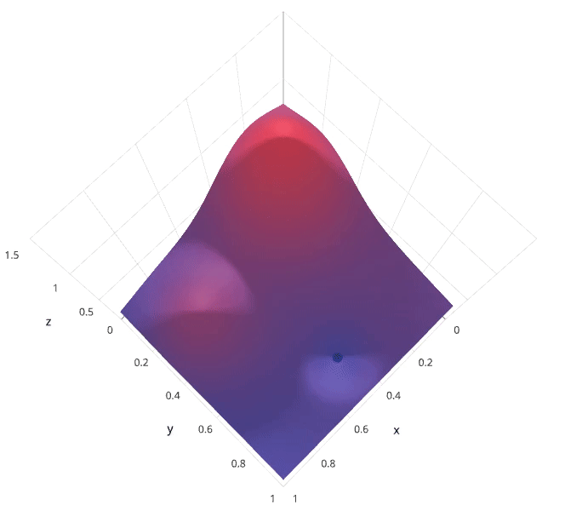
Comparison Bayesian Optimization vs Grid and Random Search
Grid Search
Random Search
Bayesian Optimization
Image source: Link access

Slide 33
2. What are important Augmentation transformation from Supervised Learning ???

Slide 34
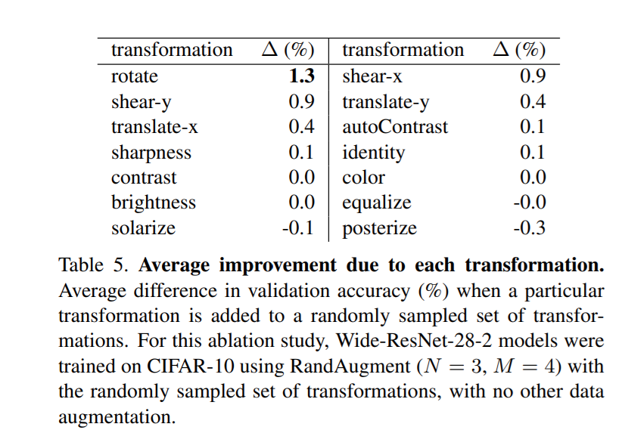
Supervised-Learning Important transformation
RandAugment Cubuk et al. 2019 (GoogleBrain)
Image source

Slide 35
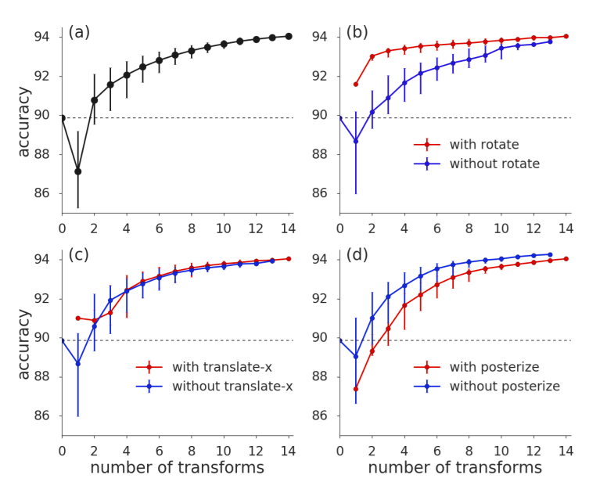
Supervised-Learning Important transformation
RandAugment Cubuk et al. 2019 (GoogleBrain)
Image source

Slide 36
Supervised-Learning Important transformation
RandAugment Cubuk et al. 2019 (GoogleBrain)

Slide 37
Supervised Learning
Data Augmentation + Regularization

Slide 38
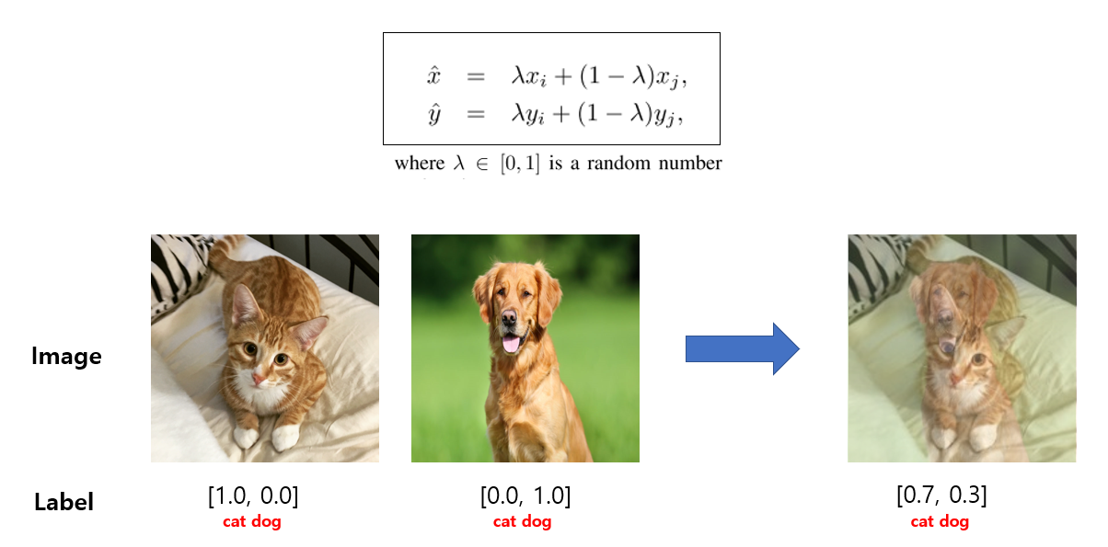
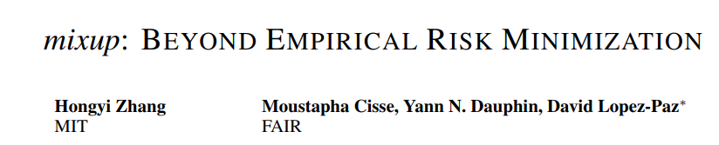
Supervised Learning – Data Augmentation Regularization
Mixup Augmentation -Regularization
Mixup Zhang et al. 2018
Image Source

Slide 39
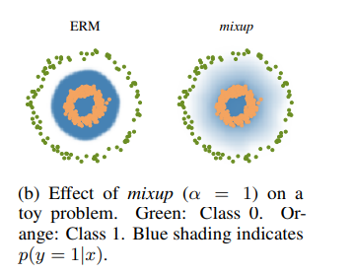
Supervised Learning – Data Augmentation Regularization
Mixup Augmentation -Regularization
Mixup Paper
Image Source

Slide 40
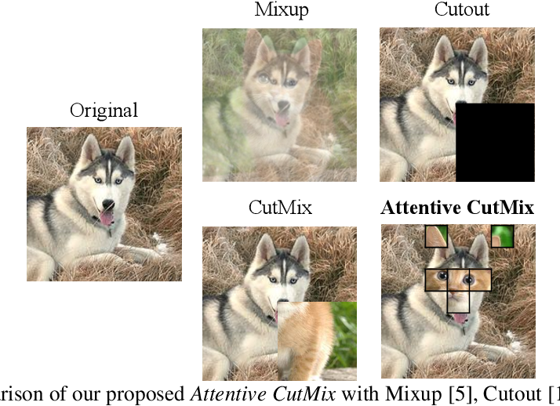
Supervised Learning – Data Augmentation Regularization
Cutout, CutMix Data Augmentation
Cutout DeVries et al. 2017
CutMix Yun et al. 2019
Image Source

Slide 41
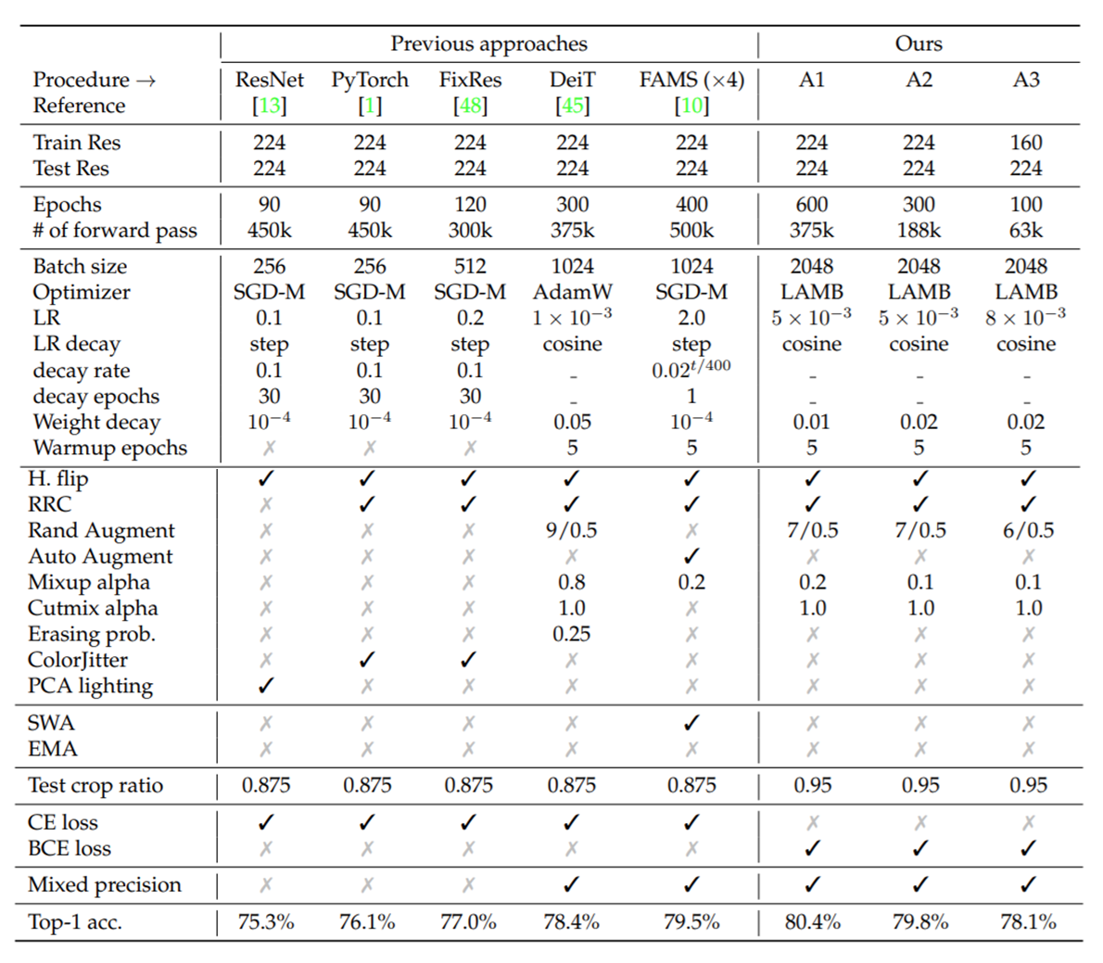
Augmentations + Regularizations
ResNet strikes back: An improved training
procedure in timm 2021 et al.

Slide 42
Current Self-Supervise Learning Data Augmentation

Slide 43
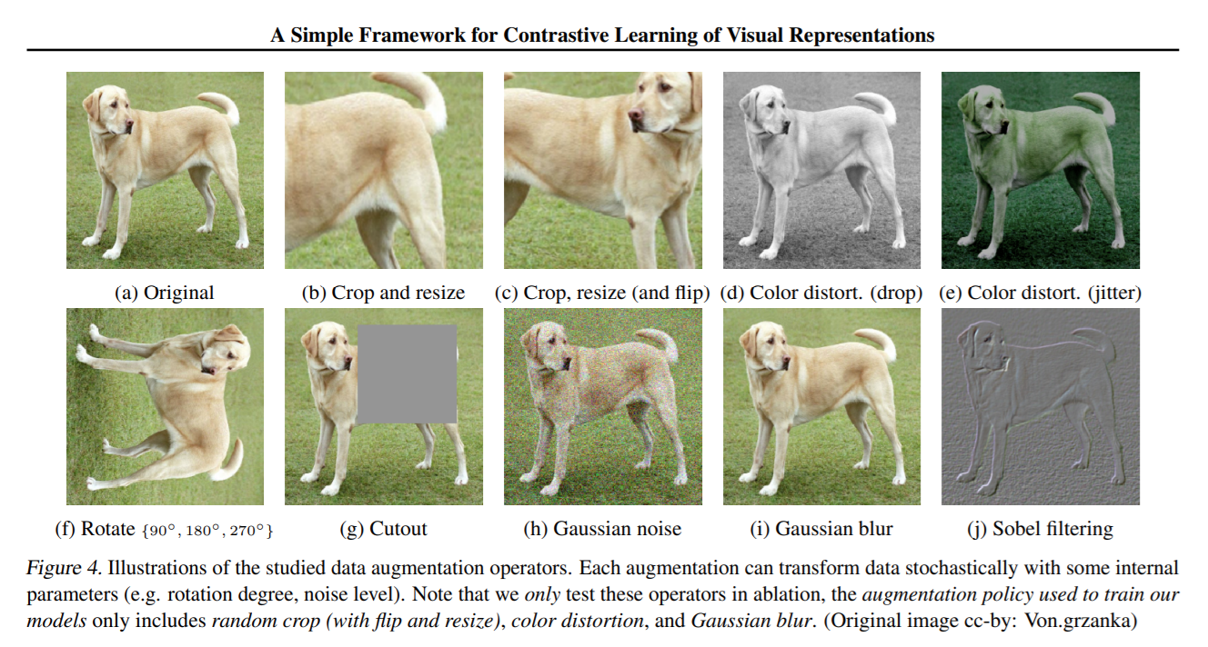
Contrastive SimCLR Data-Augmentation
SimCLR Paper Image

Slide 44
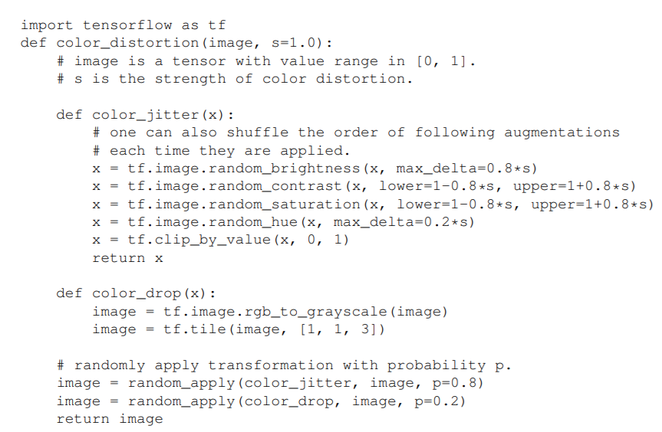
Contrastive SimCLR Data-Augmentation
Color Distortion with Random magnitude within Define (Lower and Upper bound)
Sequential Apply (Probability)
SimCLR Paper Image

Slide 45
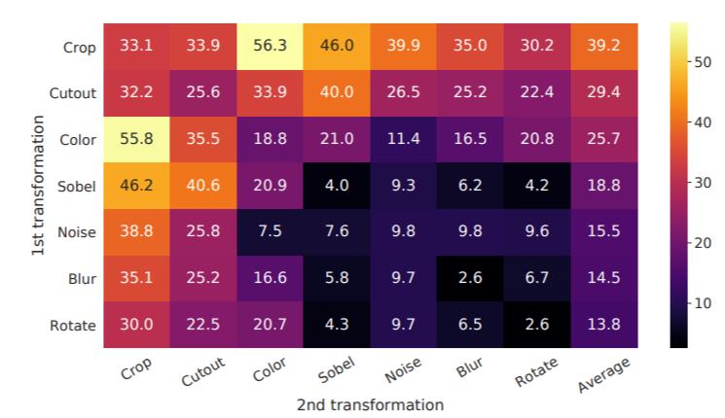
Handcrafted SimCLR Data-Augmentation
SimCLR (Positive –Negative) Augmentation Strategy
Dataset working: Natural Images (ImageNet, CoCo, Others)
Apply Single Transformation
Apply Sequential 2 Transformations
SimCLR Paper Image
BYOL, SimSam– Base on SimCLR [None – Contrastive (Positive Pair Only)]

Slide 46
2. What are important Augmentation transformations from Self-Supervised Learning ???

Slide 47
Cropping – Random Color distortion
Apply Single Transformation
Apply Sequential 2 Transformations
SimCLR Paper Image

Slide 48
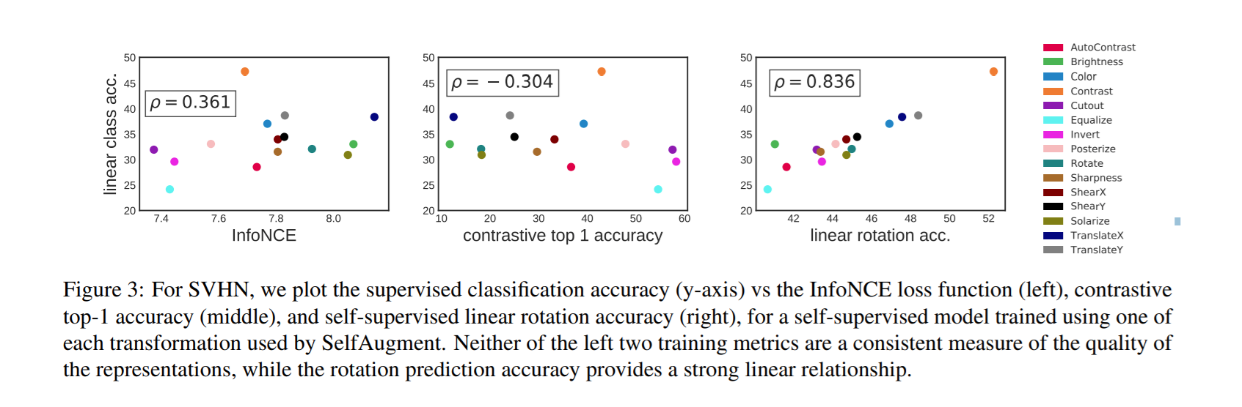
Transformation impact in self-Supervised

Slide 49
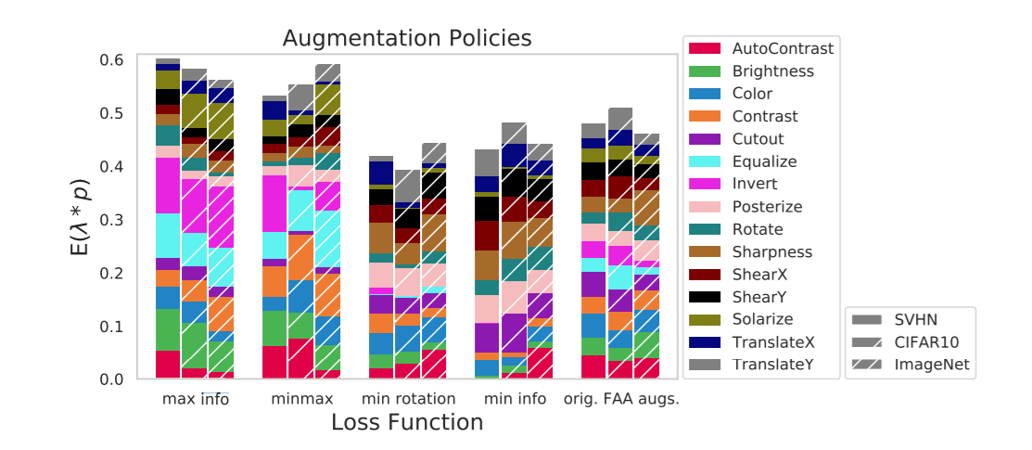

Slide 50
Multi-Crops → Multi-Resolutions Yield Better Representation Learning

Slide 51
Multi-Crops [Global & Local ] Augmentatio
Image source

Slide 52
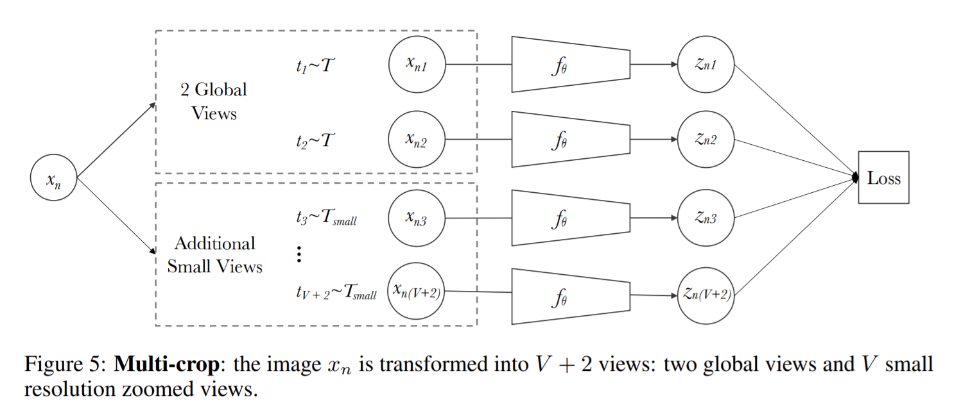
Multi-Views [Global & Local ] Only Assignment Clustering
SwAV Paper Image

Slide 53
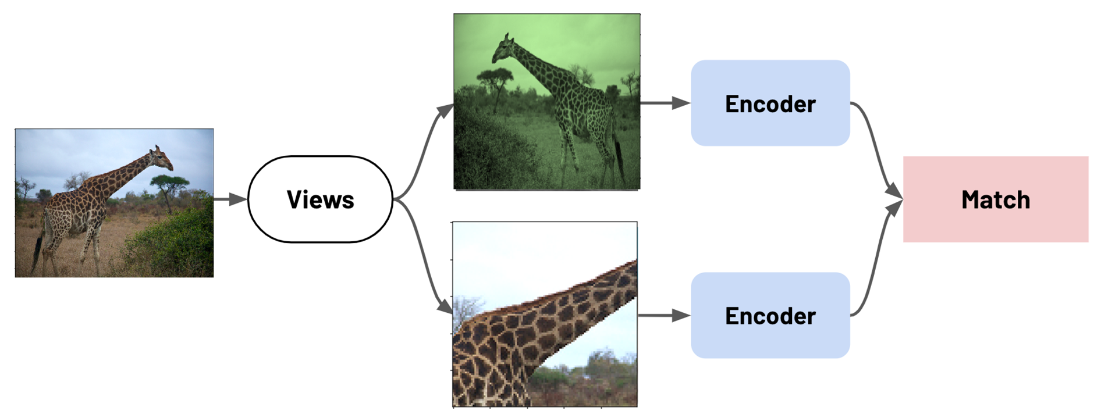
Two Views Approach Contrastive Self-Supervised

Slide 54
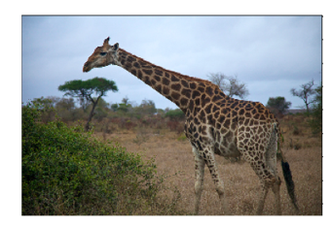
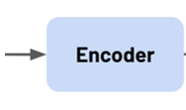
Multi-Views Approach Contrastive Self-Supervised
…
Views 4 to 6

Slide 55
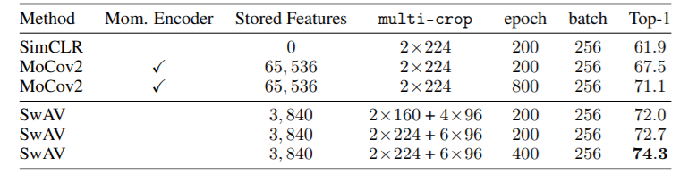
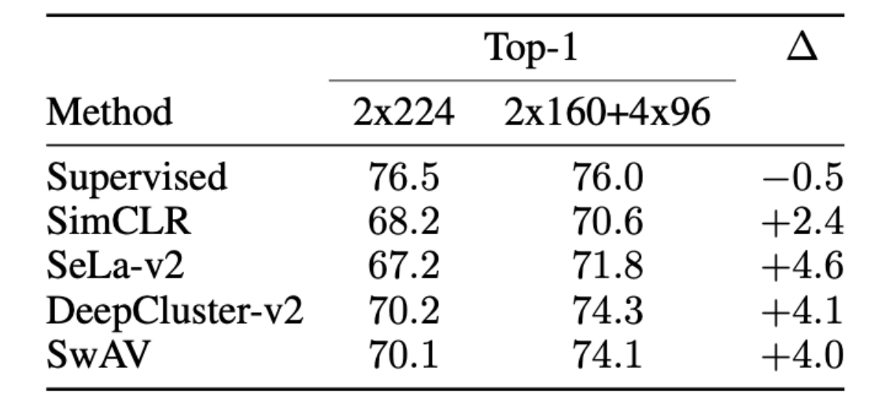
Multi-Views Augmentation Yield better Result
SwAV Paper Image

Slide 56
What We Can Learn From Self-Supervise Data Augmentation ???

Slide 57
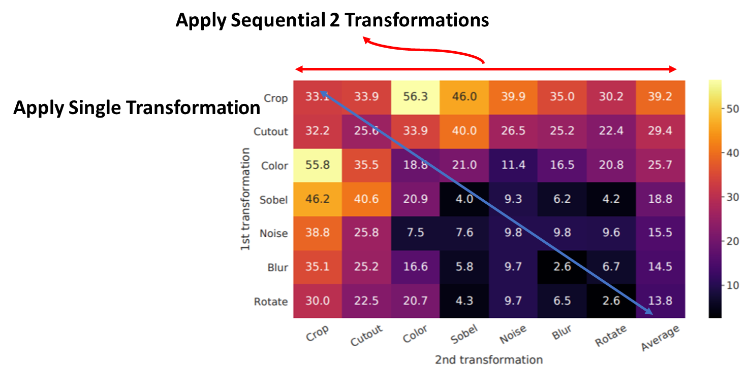
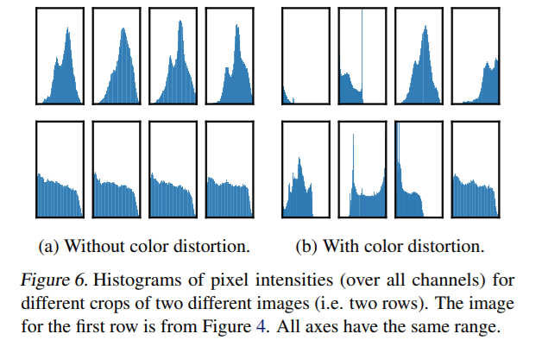
Cropping + Color Distortion are Critical Important in Contrastive Self-Supervised

Slide 58
Cropping + Color Distortion are Critical Important in Contrastive Self-Supervised
Apply Single Transformation
Apply Sequential 2 Transformations

Slide 59
Cropping + Color Distortion are Critical Important in Contrastive Self-Supervised
Apply Single Transformation
Apply Sequential 2 Transformations

Slide 60
Multi-Views --> Multi-Resolutions are Yield Better Performance on Self-Supervised Frameworks

Slide 61
Self-Supervised Learning + Regularization

Slide 62
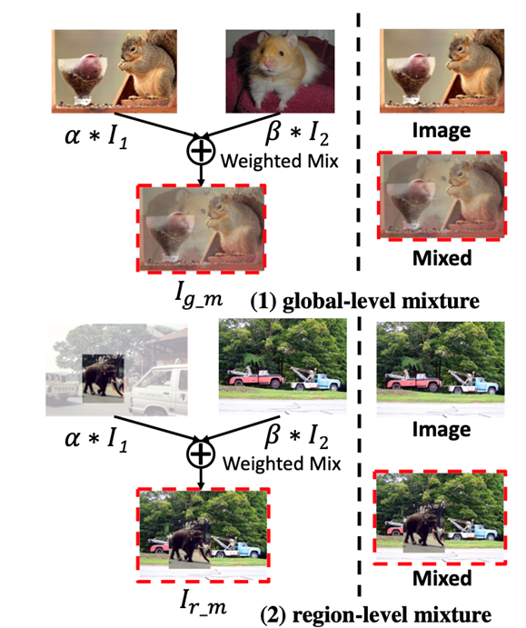
Self-Supervised –Data Augmentation Regularization
Un-Mix: Rethinking Image Mixtures for Unsupervised Visual Representation Learning Paper
Mixup
CutMix

Slide 63
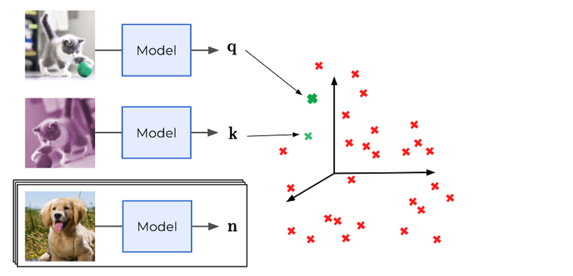
Contrastive Learning Self-Supervised

Slide 64
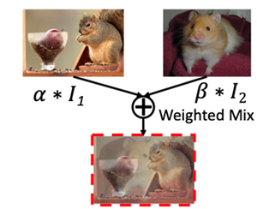
Contrastive Learning Self-Supervised

Slide 65

Self-Supervised –Data Augmentation Regularization
MixCo: Mix-up Contrastive Learning for Visual Representation (SimCLR Contrastive Learning)
Paper

Slide 66
What’s the different Data Augmentation Self-Supervised & Supervised

Slide 67

Supervised – Data Augmentation Core Values
“find a maximally compressed mapping of the input variable that preserves as much as possible the information on the output variable.”

Slide 68
Supervised – Data Augmentation Core Values
Train a machine learning model, what you’re really doing is tuning its parameters such that it can map a particular input (say, an image) to some output (a label). Our optimization goal is to chase that sweet spot where our model’s loss is low, which happens when your parameters are tuned in the right way.

Slide 69

Self-Supervised Data Augmentation Core Values

Slide 70
Self-Supervised Data Augmentation Core Values

Slide 71
3.
Proposed Multi-Augmentation Strategy.
(1. Defined – 2.Policy – 3.Random)

Slide 72
Objectives
Finding the optimal strategy of Data Augmentation for Self-Supervised (Representation Learning)
Finding the efficient – Adaptable for different tasks domains in images (Natural, Cartoon, Medical )
Multi-Strategies (Representation Learning Differently)
(The effective of Multiple strategy on Representation Learning)
Robustness of Representation Learning with Regularization
+ Contrastive Learning (Positive – Negative) + Semi-Positive (Increasing semantically Representation)
+ Non-Contrastive Learning(Positive only) + Semi-Positive

Slide 73
Combination Data Augmentation Strategies
Supervised Data Augmentation
Self-Supervised Data Augmentation

Slide 74


Multi-Strategies Augmentation
Baseline Handcrafted Defined Strategy
Random Search
Policy Bayesian optimization Search
Policy Strategy Auto Augmentation

Slide 75
Current Approach Augmentation Self-Supervised
Baseline Handcrafted Defined Strategy

Slide 76



Our Proposed Multi-Augmentation Strategies
Fast Auto-Augment
Auto-Augment
SimCLR
RandAug
Global Cropping

Slide 77
Our Proposed Multi-Augmentation Strategies
Fast Auto-Augment
Auto-Augment
SimCLR
RandAug
Global -- Local Cropping

Slide 78
Our Proposed Multi-Augmentation Strategies
+ Two-Views Augmentation Strategy
- Baseline Handcrafted Augmentation (SimCLR)
- Global Crop + Random Augmentation
- Global Crop + Policy Auto Augmentation
- Global Crop + Policy Fast Auto Augmentation
+ Multi-Crop Views Augmentation Strategy
- Multi-Crops Baseline Handcrafted Augmentation (SimCLR)
- Multi-Crops Random Augmentation
- Multi-Crops Policy Auto Augmentation
- Multi-Crops Policy Fast Auto Augmentation

Slide 79
Our Proposed Multi-Augmentation Strategies for Two-Views

Slide 80

Our Proposed Multi-Augmentation Strategies for Multi-Views

Slide 81
Strategy Augmentation
-- Baseline Self-Supervised
+ (Cropping & Color Distortion)(Experiment in Progress)
-- Supervised Random Augmentation + Self
+ Random Augmentation + Cropping
+Random Augmentation + W/O Croping
-- Supervised Bayesian Searching(Data Augmentation Policy)
+ (Fast_AA, Fast_AA_Self-Supervised)
-- Supervised AutoAugmentation Strate
+ (Auto AA)

Slide 82
Multi- Augmentation Strategies + Regularization

Slide 83
Augmentation + Regularization
Mixup
CutMix

Slide 84

Mixup Experiement in Cifar 10

Slide 85

Contrastive Self-Supervised Learning

Slide 86



Mixed Contrastive Self-Supervised Learning
Encoder
R_F 3
Semi-Similarity
1st View
R_F 1
Similarity
X
R_F 2
Encoder
Semi-Similarity
3
2nd View
R_F 3
…
Mixed Views
3rd
Dissimilarity
N
Other R_F
others Images

Slide 87



Contrastive Self-Supervised
,
,
,
,

Slide 88
Contrastive Self-Supervised
Batch N samples
1 Positive Pair
2*(N-1) (Negative pairs)

Slide 89

Mixed Contrastive Self-Supervised Learning
Batch N samples
Semi Positive Pair
1 Positive Pair
2*(N-1) (Negative pairs)

Slide 90
Mixed Contrastive Self-Supervised Learning
Batch N samples
Semi Positive Pair
Semi Positive Pair
1 Positive Pair
2*(N-1) (Negative pairs)

Slide 91

Multi-Strategy Augmentation Two Views + Regularization (Mixup & CutMix)
Conventional Approach
Distance Loss
Self-Mixtures
Distance Loss
Our Mixed Approach

Slide 92

Multi-Strategy Augmentation + Regularization (Mixup & CutMix) Multi-Views
Previous Approach
Our Approach
Self-Mixtures
Self-Mixtures

Slide 93

Order Augmentation + Regularization
Multi-Augmentation Strategy
Mixed

Slide 94
4.
Proposed method Implementation - Pipeline

Slide 95
Proposal Method Pipeline
Data Augmentation Strategies
Baseline Self-Supervised Framework
Dataset
ImageNet,
CoCo,
Evaluation Proposed Methods
Data Augmentation Strategies + Regularization
Self-Supervised Framework Regularization
Section 1
Section 2
Section 3
Section 4

Slide 96

Proposal Method Pipeline
Dataset
Training Dataset → Downstream Tasks Dataset

Slide 97




Computer Vision Dataset
1k Classes 1.4 M images
Multi-Tasks Image Dataset (Object Detection, Segmentation, Image Classification)
300M JFT Google Image Classification Dataset
21K Classes 14 M images
400M Multi-Modalities Images-Text Pair Dataset

Slide 98



Proposal Method Section 1
Dataset
Training Dataset
Image 1k ( 1M)
Images ( 1.4 M)
Finetuning and Testing on downstream Tasks dataset
Image Classification
Object Detection Dataset
CoCo & Pascal Image Segmentation Dataset
Others Image Classification Dataset
(Cifar 10,100, SHVN, etc)

Slide 99
Proposal Method Pipeline Section 2
Multi-Augmentation Strategies
Fast Auto-Augment
Auto-Augment
SimCLR
RandAug

Slide 100
Proposal Method Pipeline Section 2
Multi-Augmentation Strategies
Fast Auto-Augment
Auto-Augment
SimCLR
RandAug

Slide 101

Proposal Method Pipeline Section 2
Multi-Augmentation Strategies
Fast Auto-Augment
Auto-Augment
SimCLR
RandAug

Slide 102
Multi-Augmentation Strategies + Regularization ➔ Disentangle Representation Learning
Fast Auto-Augment
Auto-Augment
SimCLR
RandAug

Slide 103


Slide 104

Proposal Method Pipeline Section 2
Multi-Augmentation Strategies
Fast Auto-Augment
Auto-Augment
SimCLR
RandAug

Slide 105
Multi-Views Multi-Augmentation Strategies + Regularization ➔ Disentangle Representation Learning
Fast Auto-Augment
Auto-Augment
SimCLR
RandAug

Slide 106


Slide 107

Proposal Method Pipeline Section 2
Multi-Augmentation Strategies

Slide 108

Mixed-Contrastive & Contrastive Framework
Conventional Contrastive Framework
Mixed Contrastive Framework

Slide 109
Proposal Method Pipeline Section 2
Multi-Augmentation Strategies

Slide 110


Neural Net Architecture
RegNet (Well design ConvNet Architecture Memory efficient-Fit GPUs- Larger parameter – Larger Batch_size training, Efficiency in speedup training)
Neural Net Architecture
RegNet Residual Block

Slide 111
5.
Proposed method – Schedule - Expected Result

Slide 112
Study Proposed Pipeline
Structure of Paper Proposal writing
Editing Paper with Experiment Result
Submit to
Submitting Paper Journal

Slide 113
Distributed Work Pipeline

Slide 114
Distributed Work Pipeline
Rick -- Joshep
Rick -- Joshep
Rick -- Joshep

Slide 115



Distributed Work Pipeline
Write Code – Building Project
Google Colab (GitHub platform– Update)
Tracking Experiment (Weight & Bias)

Slide 116
Distributed Work Pipeline
Rick
Structure of Paper Proposal writing
Editing Paper with Experiment Result
Submit to
Submitting Paper Journal

Slide 117
TimeLine Expected
In Progress

